Slide 1
We will get started shortly.
International Science Nutrition Society – CURARE CAUSAM - ISNS 2023

Slide 2
ISNS CASE STUDY
With Erika West on Post-COVID and Intestinal Parasites
International Science Nutrition Society – CURARE CAUSAM - ISNS 2023

Slide 3
Medical Disclaimer
The information provided is for educational purposes and is not intended as medical advice, or a substitute for the medical advice of a physician or other qualified health care professionals. This is for science and educational purposes only and cannot be used in any aspect for sales or marketing. You should not use this information for diagnosing a health or fitness problem or disease. You should always consult with a doctor or other health care professional for medical advice or information about diagnosis and treatment. This is Confidential. Do not distribute—for scientific educational purposes only.
International Science Nutrition Society – CURARE CAUSAM - ISNS 2023

Slide 5
Erika West
Nutritionist and holistic health advisor, specializing in gut health and detoxification
Meta Health Practitioner
Healed her own gut issues with a vegan diet and different intestinal cleansing
Specializing in alternative remedies such as sulfur, turpentine, MMS, etc.
Developed her own gut protocol, which now also includes proprietary blends
International Science Nutrition Society – CURARE CAUSAM - ISNS 2023

Slide 6
Post-COVID
Post-COVID can be characterized by relatively typical symptoms, limitations, and health disorders that those affected by the syndrome may suffer.
The syndrome commonly presents a widespread influence on all cells, tissues, and organs in the human body, leading to significant distress and a variety of symptoms. Mental well-being is frequently impacted as well. The following symptoms may occur:
Fatigue (constant, severe tiredness)
Anosmia and ageusia (persistent loss of sense of smell and taste)
Physical weakness
Cough and shortness of breath
Lung and Heart damage
Disorders of the cardiovascular system
Muscle pain
Inflammatory reactions
Insomnia
Disorders of concentration
International Science Nutrition Society – CURARE CAUSAM - ISNS 2023

Slide 7
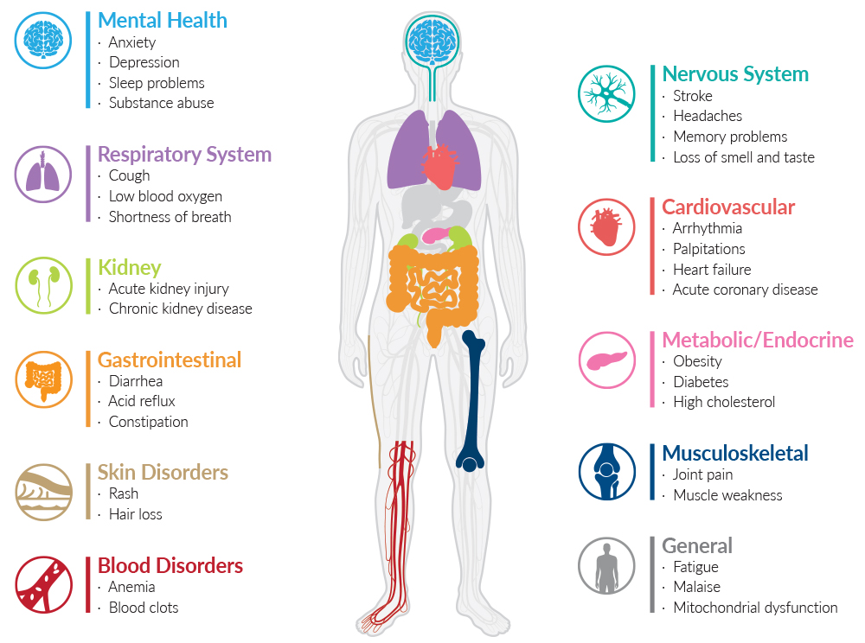
Risk Factors
Each of these factors can increase the risk of severe Covid-19 symptoms:
Older age
Lung conditions, including asthma
Heart disease
Brain and nervous system conditions
Diabetes and obesity
Cancer and certain blood disorders
Chronic kidney or liver disease
Mineral and nutrient deficiency
International Science Nutrition Society – CURARE CAUSAM - ISNS 2023

Slide 8
Causes of Post-COVID Syndrome
There are still uncertainties regarding post-COVID syndrome. At present, this also applies to the causes underlying the long-term consequences. There are still numerous ongoing investigations and studies on the syndrome in order to better understand the processes and thus also be able to treat them. Strictly speaking, post-COVID syndrome can be considered a chronic form of corona virus infection. This reaction also occurs in many other viral diseases and is not just unique to COVID-19.
One possible explanation is that the immune system of those affected suffers in the long term from the difficulty of terminating the necessarily very strong defensive reaction in the organism. According to the new guideline on COVID-19, which was developed by several professional societies, the development of post-COVID is multifactorial and partly individual.
The prolonged presence of the virus for weeks or months is believed to be a significant factor contributing to post-COVID. Current research suggests that pathologically altered processes in tissues, blood vessels, blood clotting, inflammatory responses, and the regulation of the immune and endocrine systems may also be involved. Additionally, potential side effects of administered therapies are being explored as potential contributing factors.
International Science Nutrition Society – CURARE CAUSAM - ISNS 2023

Slide 9
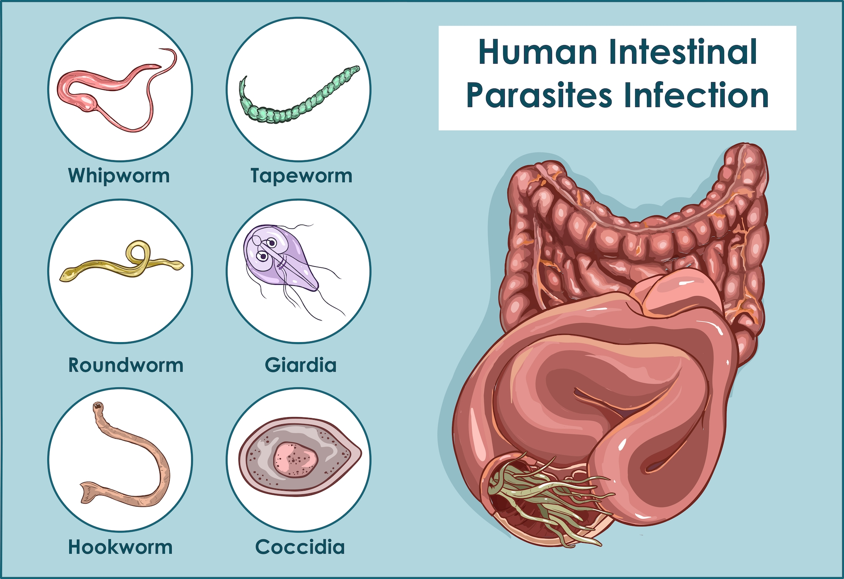
Intestinal Parasites
Intestinal parasites are organisms that live and thrive in the human digestive system, primarily in the intestines. They can include a variety of different microorganisms, including protozoa, helminths (worms), and sometimes even arthropods. These parasites can cause infections in the gastrointestinal tract and are typically acquired through the consumption of contaminated food or water, close contact with infected individuals, or exposure to contaminated soil or surfaces.
The most common types of intestinal parasites include:
Round worms
Tapeworms
Flukes
Protozoa
International Science Nutrition Society – CURARE CAUSAM - ISNS 2023

Slide 10
Causes of Intestinal Parasites
Most often, parasites enter the intestine in the egg stage through contaminated food and drinking water. However, they can also be transmitted by infected insects (e.g., fleas, ticks, mosquitos), other people, or pets.
The parasites can also be transmitted during sex. The risk of infection is notably elevated during anal intercourse, as many parasites, along with their eggs, tend to conceal themselves in fecal deposits. In the case of pinworms, for instance, they prefer the vicinity of the anus and lay their eggs there.
International Science Nutrition Society – CURARE CAUSAM - ISNS 2023

Slide 11
Causes of Intestinal Parasites
The larvae of some worms enter the blood directly through the skin. From there, they are transported to the lungs, where they can cause a severe cough or even pneumonia. They enter the throat through the respiratory tract and finally end up in the digestive tract through swallowing.
The larvae of other parasites, on the other hand, develop in the duodenum before migrating further into the large intestine and growing there.
Some intestinal parasites are also able to pierce the colon wall. This is how they enter the blood and can spread throughout the body.
International Science Nutrition Society – CURARE CAUSAM - ISNS 2023

Slide 12
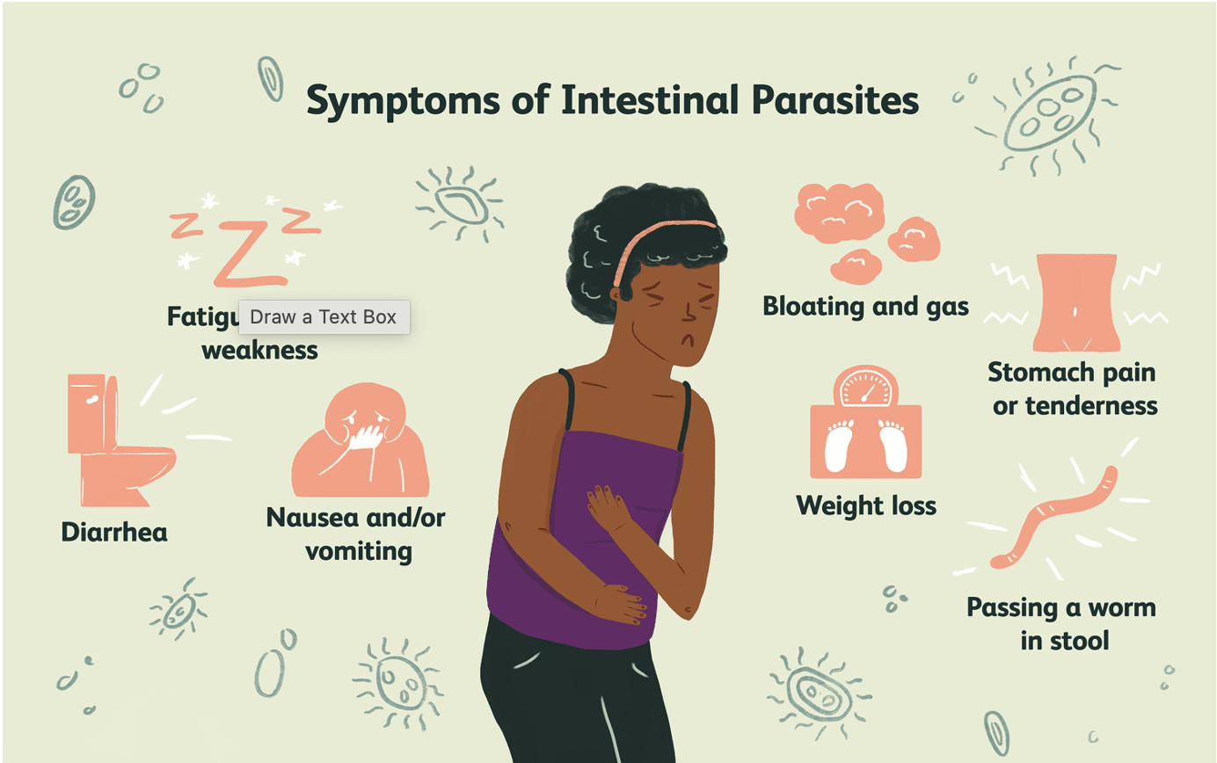
Symptoms of Parasites
Intestinal parasites can cause a wide range of symptoms, and the specific symptoms can vary depending on the type of parasite, the severity of the infection, and the individual’s overall health. Common symptoms of intestinal parasites include:
Digestive Problems
Changes in Stool
Weight Loss
Fatigue and Weakness
Anemia
Itching
Allergies
Joint and Muscle Pain
Fever
Malnutrition
Irritability and Restlessness
International Science Nutrition Society – CURARE CAUSAM - ISNS 2023

Slide 13
Intestinal Parasites Develop Survival Strategies
A strong immune system can normally prevent the intestinal parasites from implanting by producing specific antibodies. However, some parasites have developed quite perfidious survival strategies that make it impossible for the immune system to act against them.
Some intestinal parasites repeatedly change their surface structure by shedding their skin. In this way, the parasite can no longer be recognized as an invader by relevant antibodies and escape the defense mechanisms of the human host.
International Science Nutrition Society – CURARE CAUSAM - ISNS 2023

Slide 14
Intestinal Parasites Develop Survival Strategies
Other parasites release certain substances that stimulate the immune system to produce more so-called regulatory cells. This cell type suppresses the body’s healthy immune response, allowing the parasite to develop, grow, and possibly multiply undisturbed.
In addition, all intestinal parasites benefit from an unhealthy intestinal environment. The more compromised a person's intestinal condition, the more favorable it becomes for parasites to inhabit the various contaminated crevices of the intestinal wall. They may even proliferate in pre-existing diverticulitis (sac-shaped protrusions) and multiply without hindrance.
International Science Nutrition Society – CURARE CAUSAM - ISNS 2023

Slide 15
Parasites are Often Not Considered When Diagnosing
A parasite infestation is often difficult to diagnose because the parasitic symptoms are very non-specific. Many doctors often do not recognize a connection between a parasitic infection and serious illness. It is too easy to confuse the symptoms with other diseases and the therapy aimed at them will be correspondingly ineffective.
Another potential factor contributing to misdiagnosis is the limited consideration given by many medical professionals to a parasite infestation, specifically intestinal parasitosis. It appears that there is still a prevailing belief among doctors that parasites are only a concern in tropical and third-world countries, which is not accurate.
International Science Nutrition Society – CURARE CAUSAM - ISNS 2023

Slide 16
CASE STUDY
Patient: Female
Age: 35 years old
History: Family history is negative
Medical history:
Long Covid symptoms after Covid-19 infection (non-vx) and parasite infestation.
As a teenager hay fever and gut issues. After her first child tooth decay and underweight.
Followed by:
Migraine
Angina (treated with antibiotics)
Constant Infections
Sciatica Issues
Panic Attacks
Visual Problems
Rashes
Dry Skin
IBS
Aggression
Hair loss
Tachycardia
Toothache
Gingivitis
Sleep Issues
Lumbago
Tiredness and Exhaustion
A low point was reached with a COVID-19 infection with the following condition and additional symptoms: Pain all over the body, brain fog, unable to concentrate. She could only lie down and had to be fed and cared for.
International Science Nutrition Society – CURARE CAUSAM - ISNS 2023

Slide 17
Conventional Treatment
There is currently no definitive treatment against post-COVID syndrome that has been approved and the mainstay treatment is divided into Symptomatic Supportive and Rehabilitative treatment with self-monitoring.
International Science Nutrition Society – CURARE CAUSAM - ISNS 2023

Slide 18
Method
PROPRIETARY BLENDS LEGEND
Proprietary blend I from the beginning: 1 drop daily in a glass of water for 3 days, then every 3 days increase the number of drops by 1 drop every 3 days, reaching up to 6 drops. Then severe dizziness occurred, and the drops were increased to 4 x 6 drops daily.
Proprietary blend II: after 3 months, started on 1 capsule in the morning, and 1/2 sachet of Proprietary Blend III daily was added
After 6 Months
Proprietary blend IV: 2 x 1/3 teaspoon daily
Proprietary blend V: 1 capsule daily
Proprietary blend VI: 1 teaspoon daily
Proprietary Blend VII: 1 teaspoon daily
Additional Supplements:
Vitamin C and B complex infusions
Vitamin D in high doses
Omega 3
Amino Acids
Magnesium
Proprietary Blend I: Silica, Vitamin C, and Trace Minerals
Proprietary Blend II: N-acetyl L-tyrosine, Anhydrous Caffeine, L-theanine, Velvet Bean Seed, Pine Bark, Curcumin, and Vitamin D
Proprietary Blend III: Black Seed Oil, Resveratrol, Turmeric, Raspberry Ketones, Apple Cider Vinegar, Aloe Vera, and D-ribose
Proprietary Blend IV: Vitamin C, Zinc, and Vitamin D3
Proprietary Blend V: Inulin, Green Banana Flour, Apple Fiber, Bacillus Coagulans, Spirulina, Wheat Grass, Barley Grass, Alfalfa Leaf, Flaxseed, Psyllium Husk Powder, Chlorella, Broccoli, Kale, Spinach, Green Cabbage, Parsley, Aloe Vera, Cayenne Pepper, Blueberry Powder, Pomegranate Seed Powder, and MCT Coconut Oil
Proprietary Blend VI: B-Nicotinamide Adenine Dinucleotide (NAD+), Magnesium, Trace Minerals, Quercetin, Vitamin D, Vitamin C, and Vitamin K2,
Proprietary Blend VII: Hydrolyzed Bovine Collagen and Bovine Colostrum
International Science Nutrition Society – CURARE CAUSAM - ISNS 2023

Slide 19
Additional Treatment
As dizziness was a constant issue after the first month she started a parasite protocol with turpentine, psyllium husk, oregano essential oil, and daily enemas with MMS for 3 moon phases in a row. Increased Proprietary Blend I up to 60 drops daily for 2 weeks.
International Science Nutrition Society – CURARE CAUSAM - ISNS 2023

Slide 20
Results
After 1 month: She was able to sleep and her mood brightened
After 3 months: She was able to go for short walks. Dizziness has been controlled with the intake of Proprietary Blend I.
After 6 Months: She was able to run her household independently again. After 8 Months: She was able to do sports again
After 12 Months: She was able to go back to work and had enough energy for new projects.
After 18 Months: She successfully participated in her first 5.5 km run.
In the meantime, amalgam fillings and Nicos were removed, and the intestines were cleansed and rehabilitated. To date, she has done 8 parasite protocols in total.
International Science Nutrition Society – CURARE CAUSAM - ISNS 2023

Slide 21
Research Studies
International Science Nutrition Society – CURARE CAUSAM - ISNS 2023

Slide 22
Turmeric as a Possible Treatment for COVID-19-Induced Anosmia and Ageusia By A. Bert Chabot ¹ and Margaret P ²Neveen A Noor, Heba H Fahmy, Faten F Mohammed, Anwar A Elsayed, Nasr M Radwan.
A 28-year-old man with mild intermittent asthma, but no other prior nasal or oral conditions, or recognized risk factors for anosmia or ageusia. He took a single dose of a capsule supplement containing 1000 mg of turmeric extract (95% curcuminoids). Twelve hours after taking the turmeric supplement, the subject reported experiencing a restoration of both smell and taste to an intensity of 6/10 each, with 10/10 being achieved three days later.
A 25-year-old man with no chronic medical condition, prior nasal or oral conditions, or recognized risk factors for anosmia or ageusia. After the subject ingested 1000 mg of turmeric extract, he experienced complete restoration of smell and taste, with both senses rated 10/10, ten minutes after supplement ingestion.
https://www.ncbi.nlm.nih.gov/pmc/articles/PMC8502749/
International Science Nutrition Society – CURARE CAUSAM - ISNS 2023

Slide 23
Chlorine dioxide is a more potent antiviral agent against SARS-CoV-2 than sodium hypochlorite N. Hatanaka,^{a,b,c} B. Xu,ª M. Yasugi,^{a,b,c} H. Morino,^{d} H. Tagishi,^{d} T. Miura,^{d} T. Shibata,^{d} and S. Yamasaki
Objectives: To examine the anti-SARS-CoV-2 activity of the potent disinfectant Cleverin, the major disinfecting component of which is chlorine dioxide (ClO2); and to compare the results with that of sodium hypochlorite in the presence or absence of 0.5% or 1.0% fetal bovine serum (FBS).
Methods: Concentrated SARS-CoV-2 viruses were treated with various concentrations of ClO2 and sodium hypochlorite and a 50% tissue culture infective dose was calculated to evaluate the antiviral activity of each chemical.
Findings: When SARS-CoV-2 viruses were treated with 0.8 ppm ClO2 or sodium hypochlorite, viral titer was decreased only by 1 log10 TCID50/mL in 3 min. However, the viral titer was decreased by more than 4 log10 TCID50/mL when treated with 80 ppm of each chemical for 10 s regardless of the presence or absence of FBS. It should be emphasized that treatment with 24 ppm of ClO2 inactivated more than 99.99% SARS-CoV-2 within 10 s or 99.99% SARS-CoV-2 in 1 min in the presence of 0.5% or 1.0% FBS, respectively. By contrast, 24 ppm of sodium hypochlorite inactivated only 99% or 90% SARS-CoV-2 in 3 min under similar conditions. Notably, except for ClO2, the other components of Cleverin such as sodium chlorite, decaglycerol monolaurate, and silicone showed no significant antiviral activity.
Conclusion: Altogether, the results strongly suggest that although ClO2 and sodium hypochlorite are strong antiviral agents in the absence of organic matter in the presence of organic matter, ClO2 is a more potent antiviral agent against SARS-CoV-2 than sodium hypochlorite.
https://www.ncbi.nlm.nih.gov/pmc/articles/PMC8442261/
International Science Nutrition Society – CURARE CAUSAM - ISNS 2023

Slide 24
Oregano essential oil inhibits Candida spp. biofilms Mayram Hacioglu ¹, Ozlem Oyardi ¹, Alpcan Kirinti ¹
This study aimed to show the antifungal and antibiofilm activities of oregano oil (Origanum onites). The antifungal activities of some essential oils were investigated against C. spp. Among them, oregano oil was found to be the most effective oil, and further biofilm studies were conducted with it.
Oregano oil inhibited biofilm adhesion and formation of C. spp. and mature biofilms and also displayed the ability to reduce biofilm formation when they were allowed to form on surfaces previously coated with oil (up to 50% inhibition rates).
In addition, oregano oil was found to be effective against dual biofilms of Candida albicans + Staphylococcus aureus at different concentrations.
This study suggests that O. onites essential oil has useful antibiofilm effects against C. spp. The inhibitory effects of O. onites essential oil, against C. spp., were demonstrated for the first time. It also had an antifungal effect on biofilm formation and established biofilm even at MIC level.
https://pubmed.ncbi.nlm.nih.gov/33915040/
International Science Nutrition Society – CURARE CAUSAM - ISNS 2023

Slide 25
The essential oil of turpentine and its major volatile fraction (α- and β-pinenes): A review Michael Prost
However, other studies report the antibacterial effect of these terpenes on both Gram-negative and Gram-positive bacteria as well as a strong antifungal activity
The mechanism through which α- and β-pinenes are active against yeast or bacteria lies mainly in their capacity to induce toxic effects on the membrane structure and functions.
Terpenes, containing the first or second largest part of α-pinenes, fight against bacteria and all kinds of fungi.
The β-pinenes also show antifungal properties [68], especially on Candida spp. [36]. When acting on yeast, they were found to inhibit mitochondrial respiration, the proton pump activity, and K+ transport, and to increase membrane fluidity [69]. They also exhibit pest-destroying properties against the protozoon Plasmodium berghei (malaria vector [70]), insecticidal properties against lice [71] and the mosquito Aedes aegypti [51] as well as an antiseptic effect on oral bacterial fora [50].
Hippocrates, Dioscoride, and Galen used the oil for its properties against lung diseases and biliary lithiasis. It was also used for the treatments of blennorrhoea, cystitis, neuralgia, rheumatism, sciatica, nephritis, constipation, and mercury salivation in the past [10][11][12]. Modern phytotherapy revealed the intensive potential of terpenic oil including analgesic, revulsive, antiparasitic, disinfectant, balsamic, and respiratory and urinary tract infections, hemostatic, dissolving cholelithiasis, diuretic, antispasmodic, antirheumatic activities, etc.
https://www.researchgate.net/publication/41669083_The_essential_oil_of_turpentine_and_its_major_volatile_fraction_a-_and_b-pinenes_A_review
International Science Nutrition Society – CURARE CAUSAM - ISNS 2023

Slide 26
References
https://www.ncbi.nlm.nih.gov/pmc/articles/PMC8502749/
https://www.ncbi.nlm.nih.gov/books/NBK570608/
https://www.ncbi.nlm.nih.gov/pmc/articles/PMC8502749/
https://www.ncbi.nlm.nih.gov/pmc/articles/PMC5756309/
https://pubmed.ncbi.nlm.nih.gov/33915040/
https://www.researchgate.net/publication/41669083_The_essential_oil_of_turpentine_and_its_major_volatile_fraction_a-_and_b-pinenes_A_review
International Science Nutrition Society – CURARE CAUSAM - ISNS 2023

Slide 27
Thank You for Joining Us This Week!!
International Science Nutrition Society – CURARE CAUSAM - ISNS 2023

